Slide 1
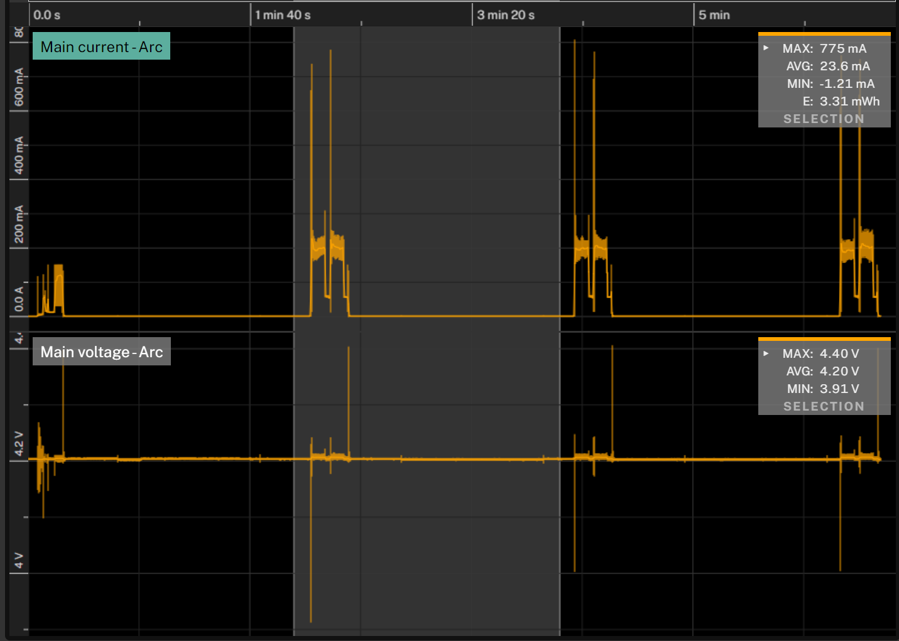
Combined power consumption of logger and wiper
Energy consumed per minimum 2-minute cycle is 3.31mWh as shown shaded in grey
Energy consumed per wipe is 3.24mWh, add sleep time/energy to calculate other time step options
Current peak is 775mA
Voltage = 4.2V as supplied by 4000mAh LiPo battery
The first two wipe points show master and slave cylinder head diff. = 0mm, the third shows head diff. = 900mm effect (easier to push but harder to pull against head pressure)
Extend brush
Retract brush
0mm head effect
900mm head effect
Start-up
Sleep current = 238uA

